Slide 1
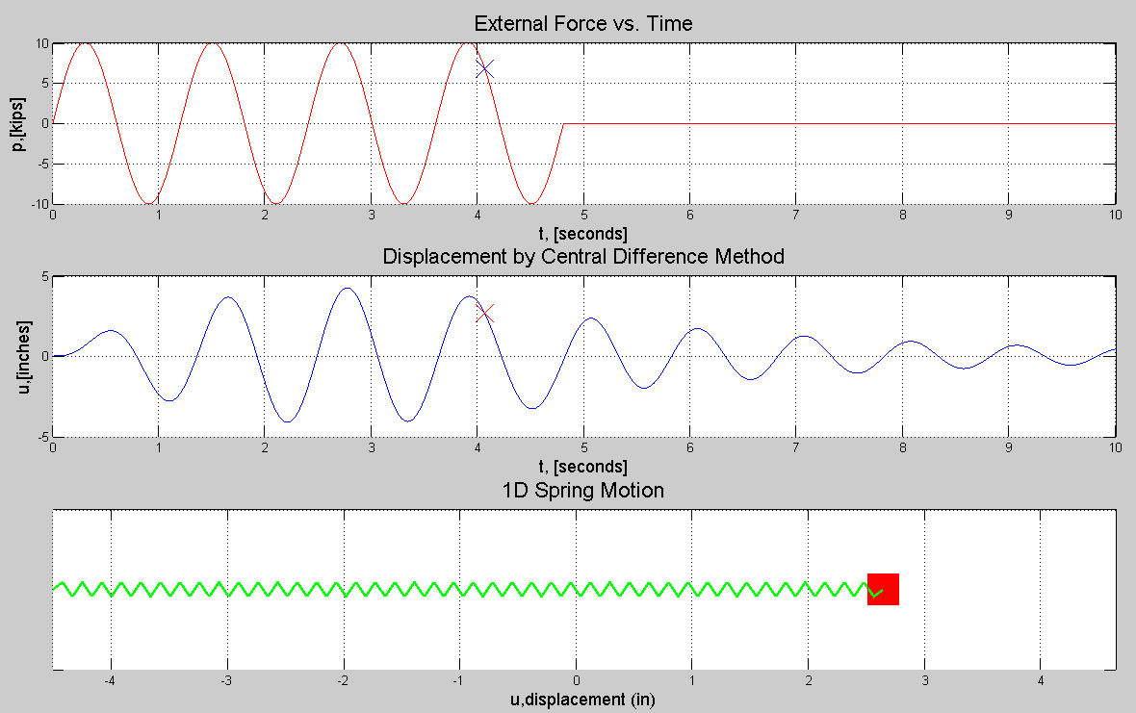
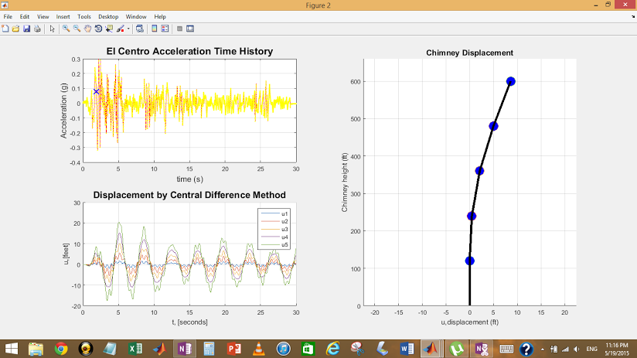
NUMERICAL EVALUATOR OF DYNAMIC RESPONSES OF SINGLE/MULTIPLE DEGREE(S) OF FREEDOM STRUCTURES
BY: KEVIN YONGCHUL KIM
Presented: May 21st, 2015

Slide 2
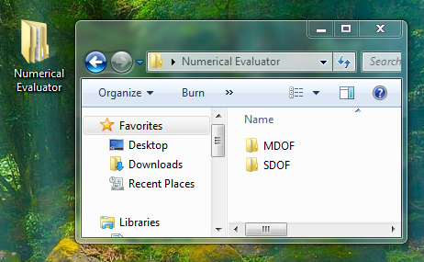
Overview
Numerical Evaluator
Complementary Learning Module
Two sets of MATLAB based programs
Single Degree of Freedom System (SDOF)
Multiple Degrees of Freedom System (MDOF)
USER INPUTS:
Structural Properties (i.e. mass, stiffness, damping ratio)
Forcing Functions or Earthquake Acceleration Data
OUTPUTS
Plots of Forcing Functions
Plots of Displacements vs. Time
Animation of Given Structure’s Response

Slide 3
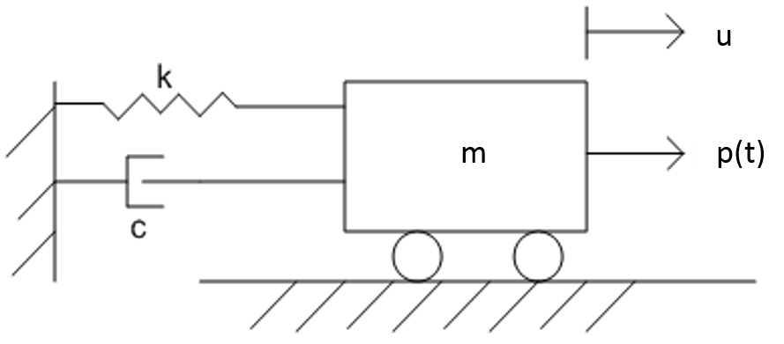
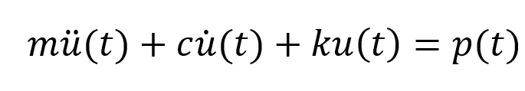
Single-Degree-of-Freedom Model

Slide 4
To Run SDOF Program
Step #1: ENTER values into User_Input.m
Step #2: ENTER values into Forcing_Function.m
Step #3: RUN Project_Begin.m

Slide 5
Step #1: Fill Up User_Input.m
Step #1: User_Input.m
Define mass m, damping ratio ξ, stiffness k, initial conditions
Select Numerical Analysis Type
Central Difference Method
Newmark’s Method
Runge-Kutta Method
Decide time step ∆t and time range
State the Type of Forcing Function
‘1’ for Recorded Ground Motion
‘2’ for Theoretical Forcing Function

Slide 6
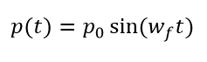
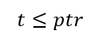
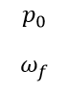
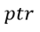
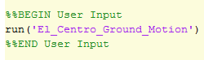
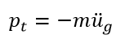
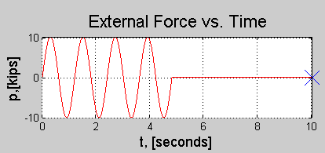
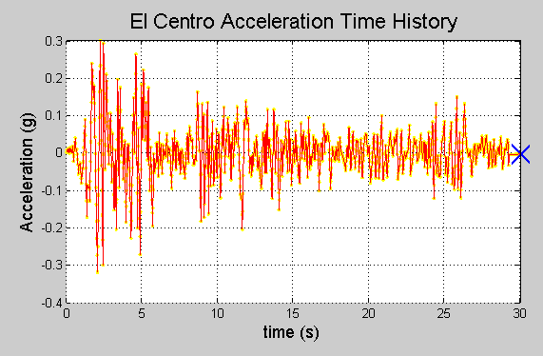
Step #2: Fill up ForcingFunction.m
Create a force vector p(t)
Option #1: Theoretical Forcing Function
Sample Forcing Input #1: Harmonic Function
Option #2: Feed Recorded Ground Motion
Sample Forcing Input #2: El Centro EQ
User Defines:

Slide 7
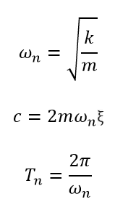
Step #3: Run Project_Begin.m
Output will display
Creates intermediary variables and vectors
Time vector [t]
Natural frequency, damping coefficient, natural period
Runs Numerical Analysis Method of User’s Choice
Central Difference Method
Newmark’s Method
Runge-Kutta Method

Slide 8
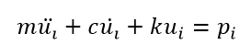
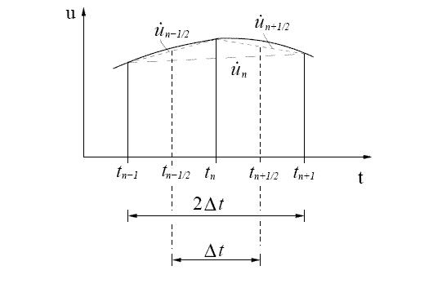
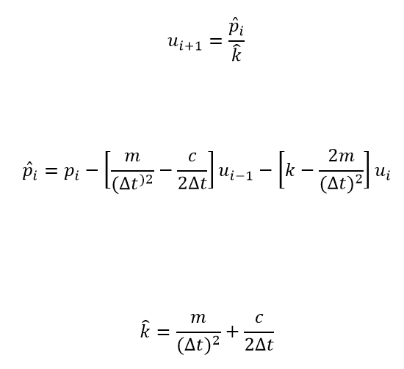
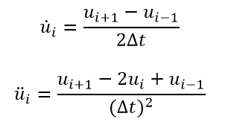
Central Difference Method
finite difference approximation of the time derivatives of displacement (i.e.velocity, acceleration)

Slide 9
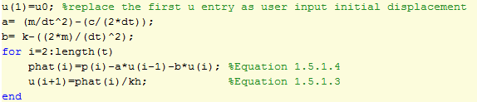
Central Difference Method Coded

Slide 10
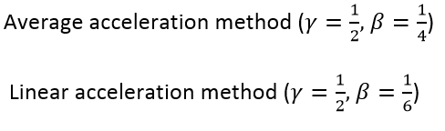
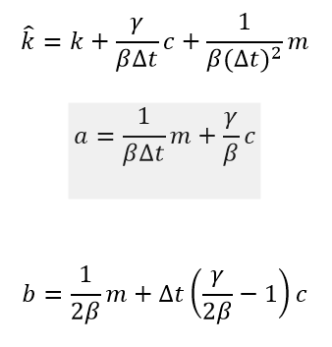
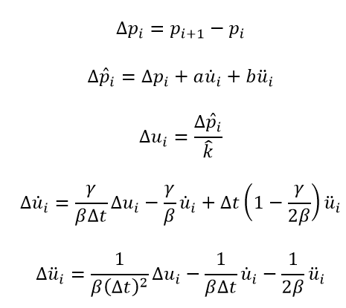
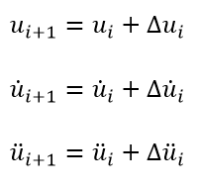
Newmark’s Method
Method based entirely on acceleration
Iterative Steps
Attaining Responses
Initial Variables

Slide 11
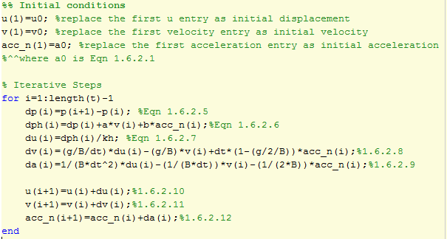
Newmark’s Method Coded

Slide 12
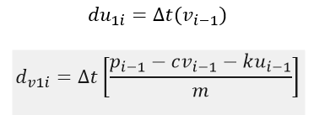
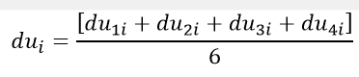
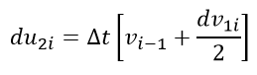
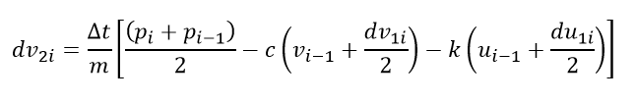
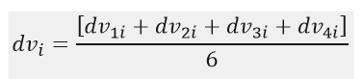
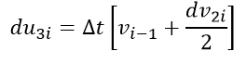
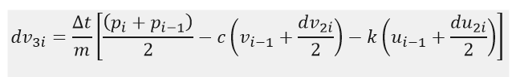
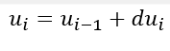
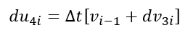
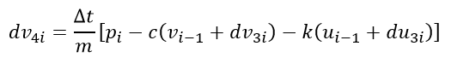
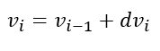
Runge-Kutta 4th Order Method
Uses weighted average of four individual slopes to attain slopes for displacement and velocity to increase by for a given time step

Slide 13
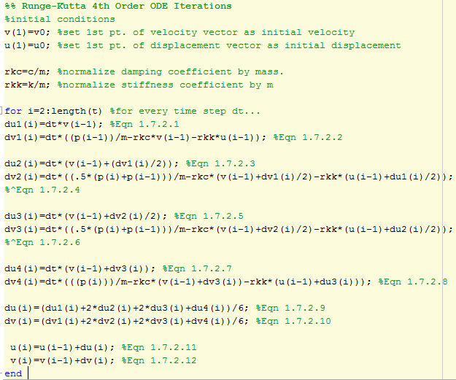
Runge-Kutta 4th order in Matlab

Slide 14
Plots and Animations
After any of the above iteration methods
Position vector [u] matching time vector [t] is created.
Outputs three subplots

Slide 15
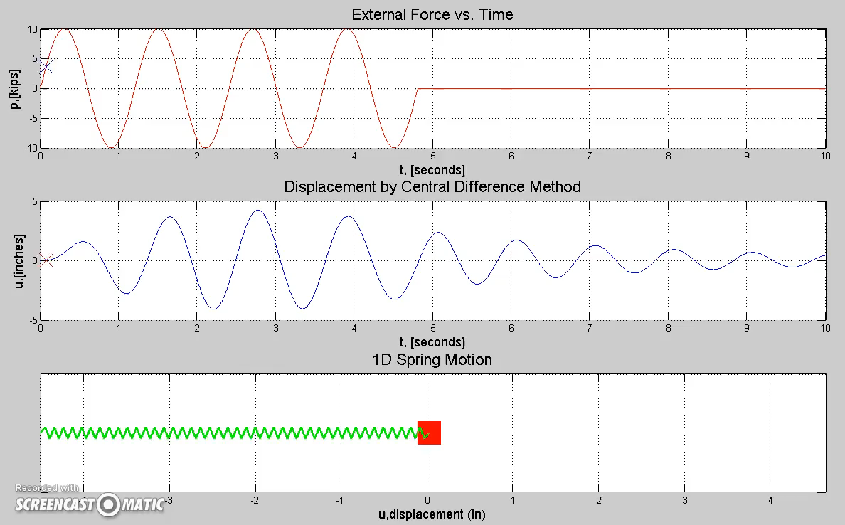
Theoretic Forcing Function

Slide 16
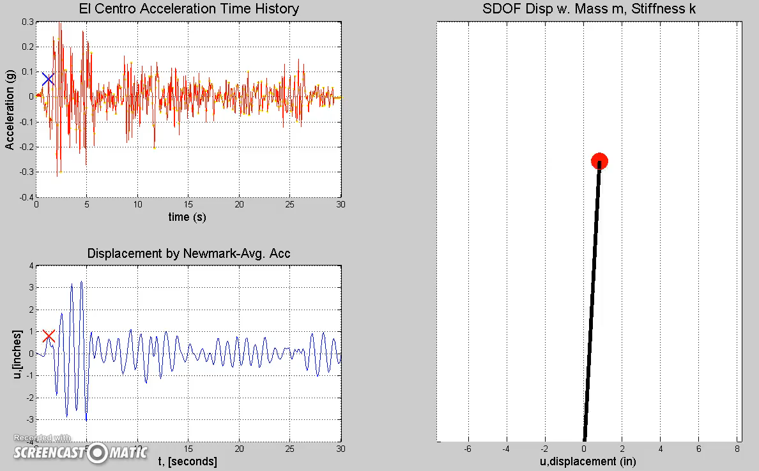
Ground Motion

Slide 17
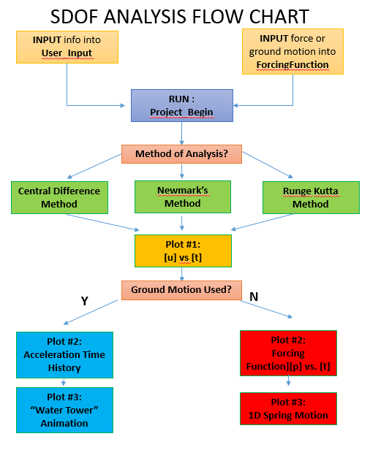
SDOF Flowchart

Slide 18
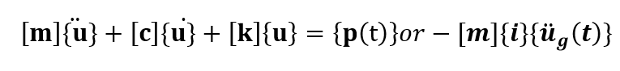
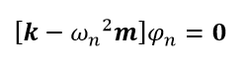
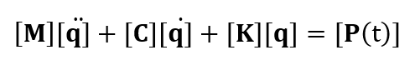
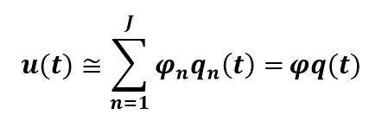
Multiple-Degrees-of-Freedom Overview
Equation of Motion turns into vectors and matrices
Modal frequencies and mode shapes attained.
Uncoupled matrices attained
Modal coordinates, [q], [q’], [q”] attained by numerical analysis similarly to u, u’,u” attained in SDOF case.
Real Displacements Attained by multiplying mode shapes by modal coordinates

Slide 19
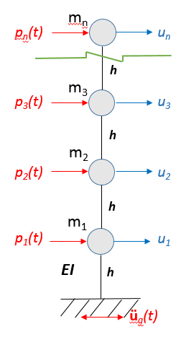
MDOF Model
Reinforced-Concrete Chimney Model
Idealized as lumped mass cantilever
User specifies:
Height of chimney
# of nodes
Stiffness of columns
Masses of each nodes
Damping ratio of the first two modes.
Forcing Function incurred at each node
OR
Recorded Ground Motion

Slide 20
To Run MDOF Program
Step #1: ENTER values into User_Input_MDOF.m
Step #2: ENTER values into MDOF_ForcingFunction.m
Step #3: RUN MDOF_Run.m

Slide 21
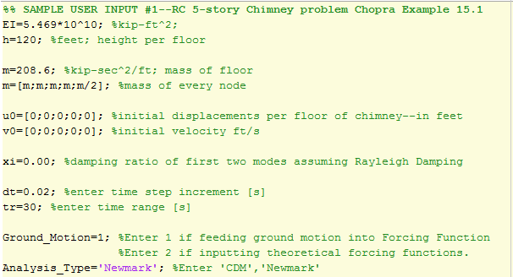
Step #1:User_Input_MDOF.m
User specifies:
Structural Properties
Initial conditions of every node
Specify Forcing Function
1:ground motion
2:theoretic function
Select Analysis Type
Select time step, time range
User implicitly specifies # of nodes!

Slide 22
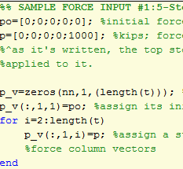
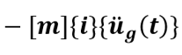
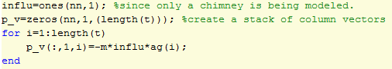
Step #2: Fill up MDOF_ForcingFunction.m
Creates stacks force vectors [p(t)]
Option #1: Theoretical Forcing Function
Sample Forcing Input #1: Step force at top story
Option #2: Feed Recorded Ground Motion
Sample Forcing Input #2: El Centro EQ

Slide 23
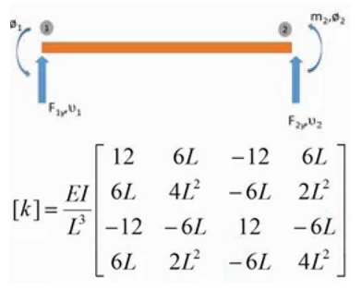
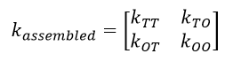





Step #3: Run MDOF_Run.m
Output will display
Creates intermediary matrices
Mass Matrix [m]: Diagonal matrix where m_{ii}=m_{i}
Statically condensed stiffness matrix $\hat{[k]}$
Modal frequencies vector [$ω_{n}]$ arranged in ascending order
Mode Shape Matrix [$φ$] : each column::each modal freq.
Rayleigh Damping Matrix [c]
Create uncoupled matrices [M], [C], [K]

Slide 24
Central Difference Method-MDOF
SDOF
All scalar equations of SDOF Central Difference Method become matrix equations
Add’l features:
Transform modal coordinates to nodal displacements
Invert matrices at certain steps
MDOF

Slide 25






CDM-Initial Calculations
Initial calculations:
u->[q];m->[M]; c->[C]; k->[K]

Slide 26







CDM Iterations:

Slide 27


Newmark’s Method—MDOF
Equations of Incremental equilibrium in SDOF Newmark’s Method
Now Matrix Equations
Average Acceleration Method
Unconditionally stable
Linear Acceleration Method
Stable when dt < 0.551 Tj
Where j is the amount of modes included in analysis.
Otherwise solution blows up, giving meaningless results.

Slide 28

Newmark’s Method Initial Calculations

Slide 29













Newmark’s Method Iterations

Slide 30
MDOF Plots and Animations
After any of the above iteration methods
Modal coordinate matrix [q], Position matrix [u] matching length of time vector [t] are created
Outputs a set of three plots

Slide 31

Theoretic: Step Force 1000k @ Top on 5th story

Slide 32

EQ: El Centro—4-story chimney

Slide 33
Power Spectral Density Plot
Fast Fourier Transform
Converts periodic functions as functions of its frequency and amplitude
Produces complex numbers
Power Spectral Density Function
Gets the norm of complex numbers
Allows plotting: Amplitude’s variance along frequency
Optional User Input

Slide 34

Power Spectral Density Plot: Free Vibration w. initial displacement at top degree-of-freedom

Slide 35

Power Spectral Density Plot: El Centro EQ

Slide 36

Flowchart MDOF Program

Slide 37

Learning Module Exercise:
Find (by hand or program) the modal frequencies and mode shapes of a chimney idealized as a 3-degrees-of-freedom system as shown.
Enter each mode shapes into the initial displacement conditions under script User_Input_MDOF.m, and set it to free-vibration under script MDOF_ForcingFunction.m
Comment on what you observe in terms of modal frequencies, mode shapes, modal coordinates and actual displacements.
EI

Slide 38


Exercise Continued
Modal Frequencies w1,w2,w3, with corresponding mode shapes
(rad/s)
EI

Slide 39

Free Vibration: Initial Disp.=Mode Shape 1

Slide 40

Free Vibration: Initial Disp.=Mode Shape 3

Slide 41
Conclusion
Presented Walkthroughs of SDOF/MDOF Analysis Programs
User Inputs
Forcing Functions
Numerical Analysis
Plots
Animations
Fast Fourier Transform
Displayed Potential for its use as learning module
Video demo for lecture
Input-Output Program for verification
Homework Ex. for understanding all relations of MDOF natural frequencies, mode shapes, modal coordinates, real displacements

